Slide 1
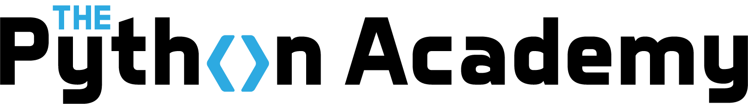
Python for Application Development
By Keenan Moukarzel

Slide 2

Agenda for Today
What is Application Development?
History of Application Development
Installing our software and packages
Let’s get coding!
Page 1
All rights reserved, The Python Academy

Slide 3
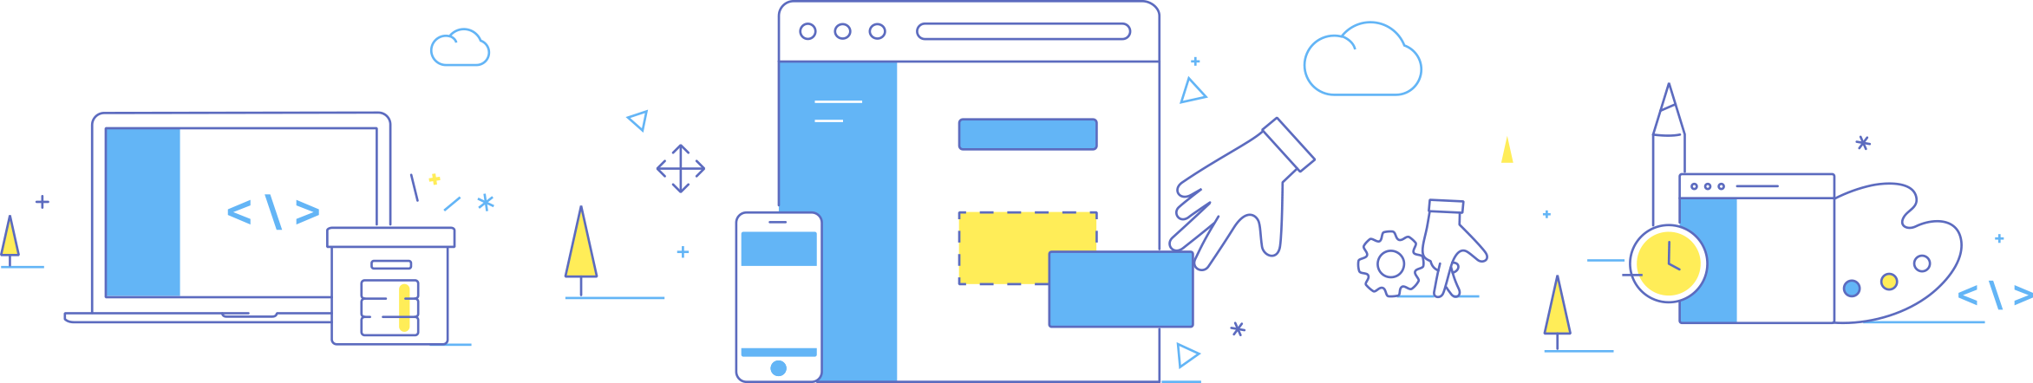
Concepts
Application development is the process of creating a computer program or a set of programs to perform the different tasks that a business requires. From calculating monthly expenses to scheduling sales reports, applications help businesses automate processes and increase efficiency.
Page 1
All rights reserved, The Python Academy

Slide 4
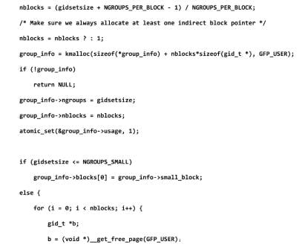

Concepts
Page 1
All rights reserved, The Python Academy

Slide 5
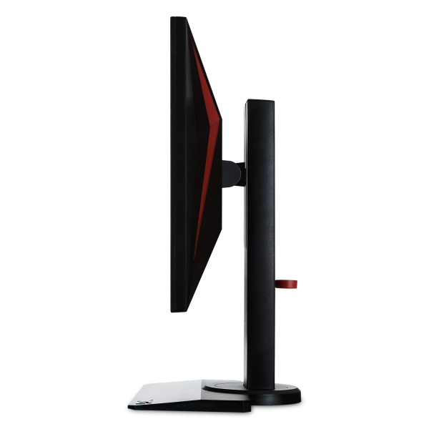
Concepts
Page 1
All rights reserved, The Python Academy

Slide 6
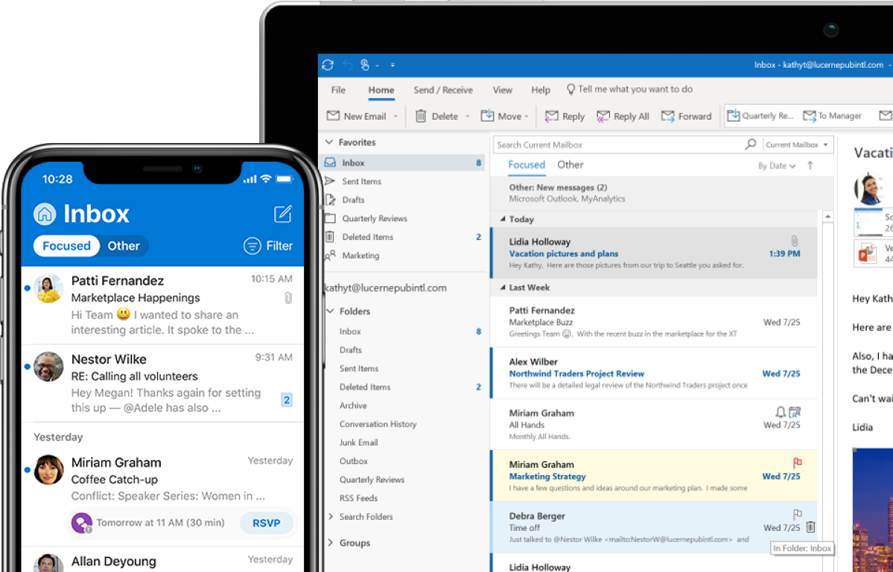
Concepts
Page 1
All rights reserved, The Python Academy
Notes:
Same concepts, different hardware / devices!

Slide 7
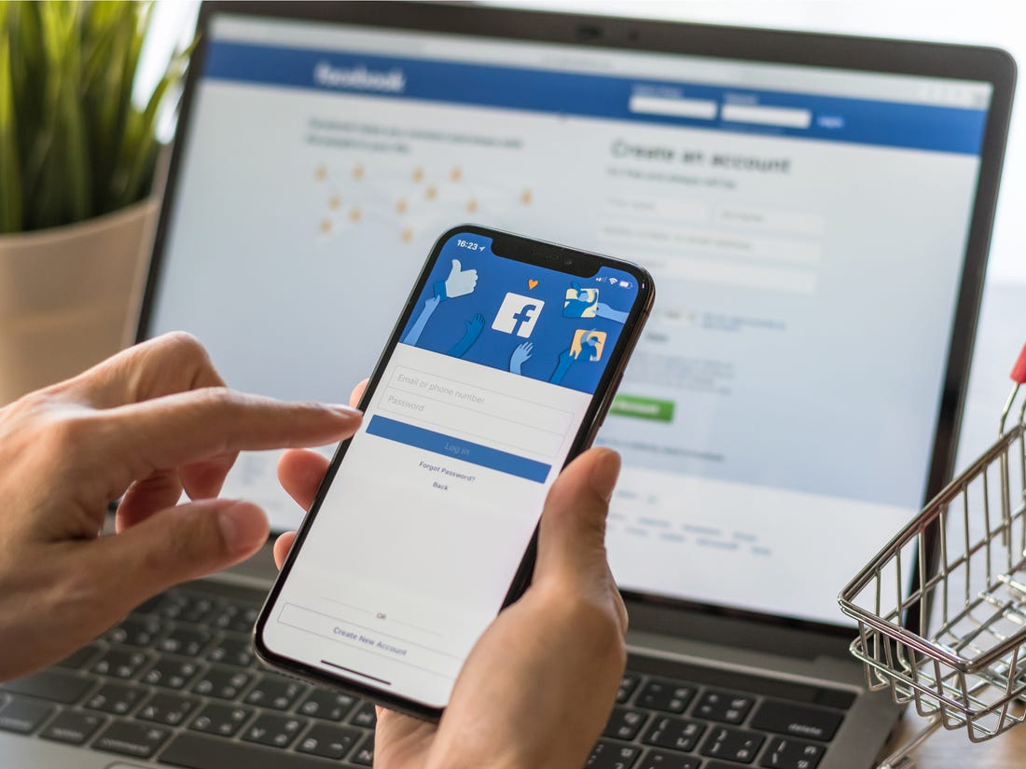
Concepts
Page 1
All rights reserved, The Python Academy
Notes:
Same concepts, different hardware / devices!

Slide 8
Concepts
The Principals of Application Development remain the same regardless of which platform or language you build your logic in!
Principle #1: User FIRST
Principle #2: Change is Constant
Principle #3: Separation of Concerns
Principle #4: Spend time to build a strong architecture
Principle #5: Test, test, test
Page 1
All rights reserved, The Python Academy

Slide 9
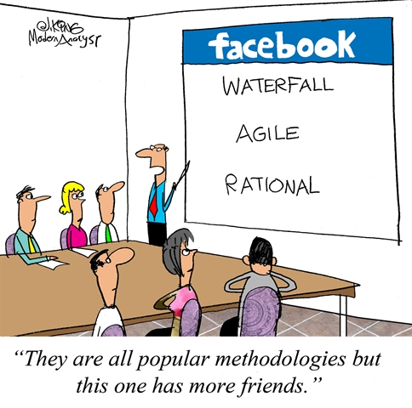
Software Development LifeCycles
Page 1
All rights reserved, The Python Academy

Slide 10
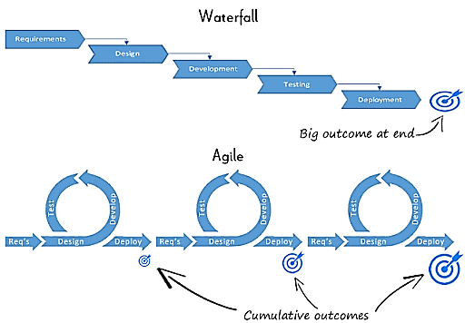
Software Development LifeCycles
Page 1
All rights reserved, The Python Academy

Slide 11
Concepts
The Different Component of Software Development:
Functionality
The Graphical User Interface (GUI)
A Data Store
Application Logging
Monitor usage
Debug defects
Application Security
Log in / password protection
Page 1
All rights reserved, The Python Academy

